Slide 1
Pay Pool Views
Notes:
This is the tenth presentation in the 18-part series for CWB training. The following slides cover how administrators can pre-set pay pool views and columns.

Slide 2
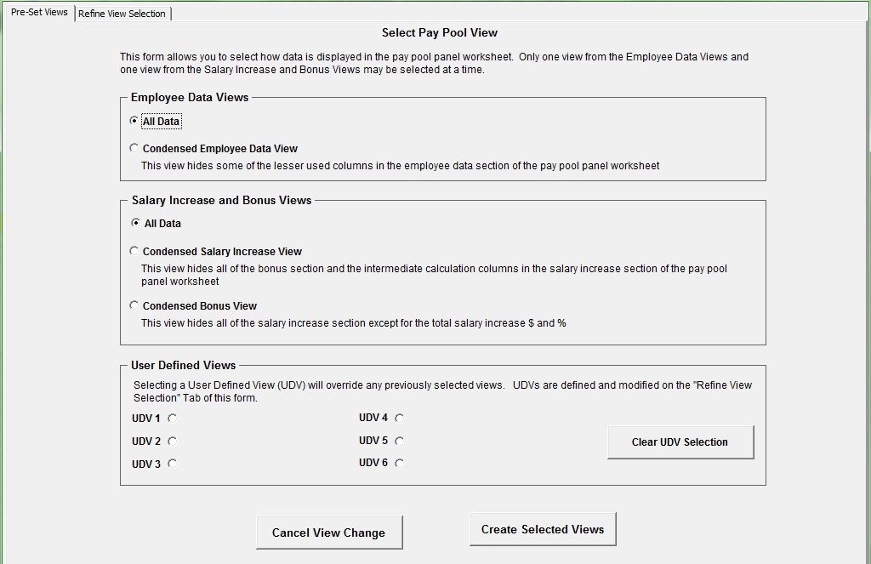
Pay Pool Views: Pre-Set
Notes:
This slide shows that some pay pool views are already pre-set.

Slide 3
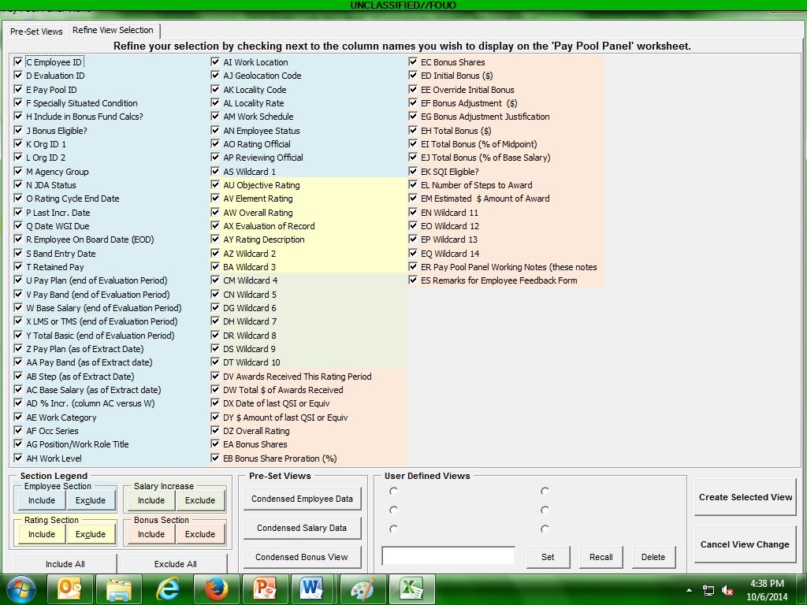
Pay Pool Views: Refined
Notes:
This slide shows how you can exclude certain columns that you do not want to view.

Slide 4
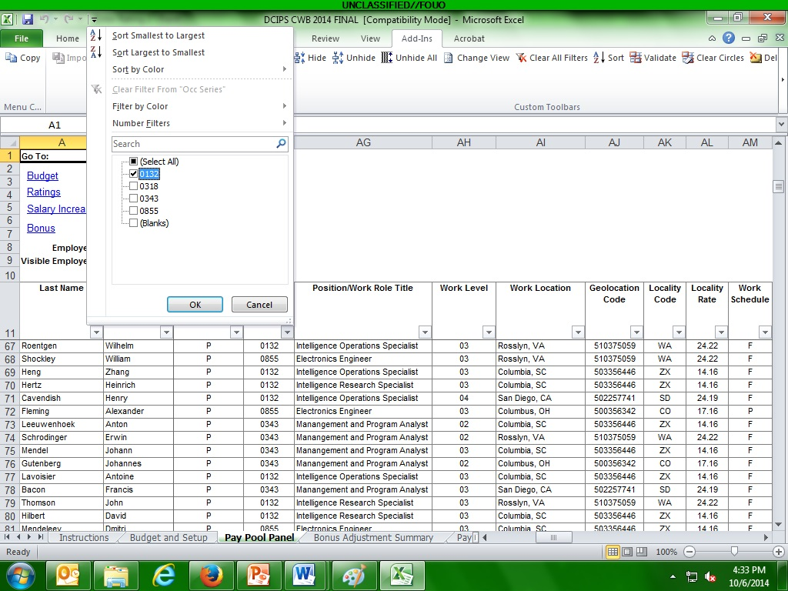
Add-ins: Filters
Notes:
You can only sort or filter the columns utilizing the “Add-Ins” tab.

Slide 5
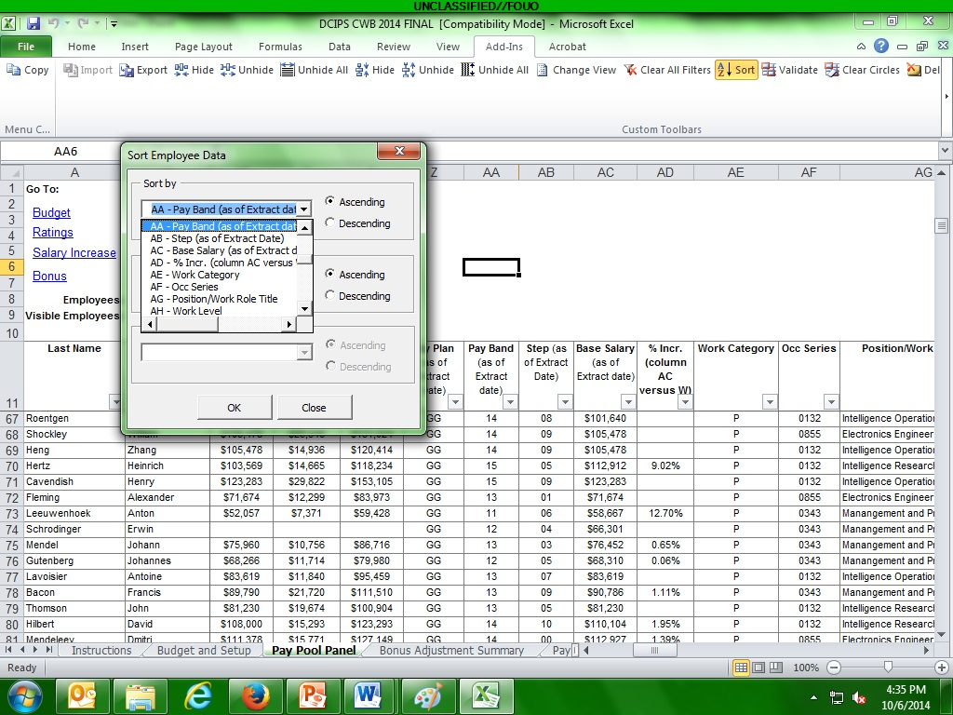
Add-ins: Sort
Notes:
This slide shows how to sort columns.

Slide 6
Bonus Section
“Sort Rating”
Sorts Highest to Lowest
Notes:
This slide gives an example of sorting the worksheet by overall ratings.

Slide 7
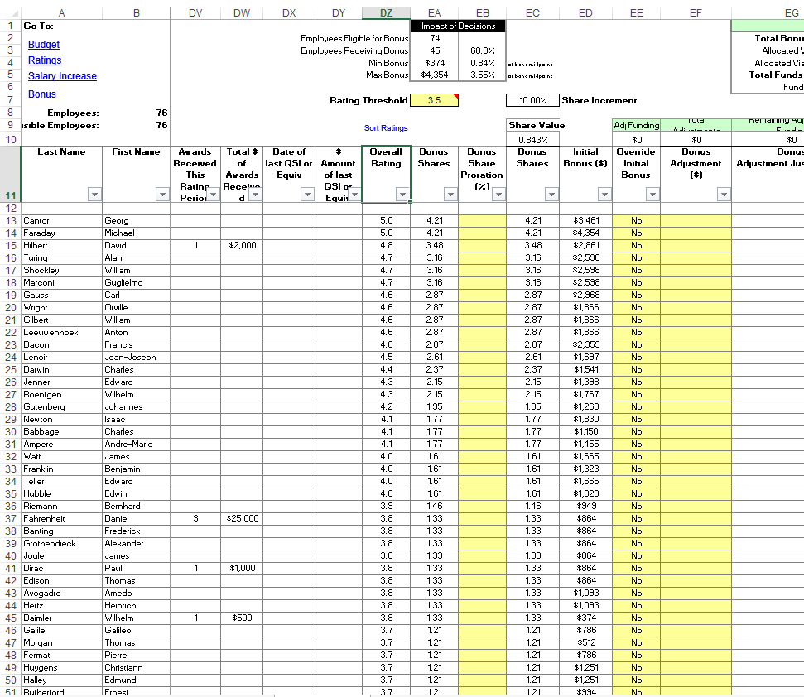
Rating Threshold
Change “Rating Threshold” determines bonus shares cut off and dollar amount from algorithm
Notes:
This slide shows how to change the rating threshold. Changes will appear in the Impacts of Decisions block right above the “Rating Threshold” cell. Rating threshold can be adjusted until the Impacts of Decisions block shows acceptable amounts.

Slide 8
To continue CWB training, view next presentation
“Bonus Adjustments”
Notes:
This concludes the tenth presentation in the 18-part series for CWB training. To continue training, view the next Presentation, entitled Bonus Adjustments.

