Slide 1
Bonus Adjustments
Notes:
This is the eleventh presentation in the 18-part series for CWB training. The following slides cover how to prorate and adjust bonus amounts.

Slide 2
Bonus Share Proration %
“Bonus Share Proration (%)”
Prorates a person’s bonus share.
All Bonus Amounts fluctuate until all adjustments, overrides, and prorations are completed
Notes:
This slide shows how to prorate bonus shares, based on pay pool business rules. Use the proration column to prorate a person’s bonus shares. Bonus dollars will fluctuate until all prorations, adjustments, overrides, etc. are finished.

Slide 3
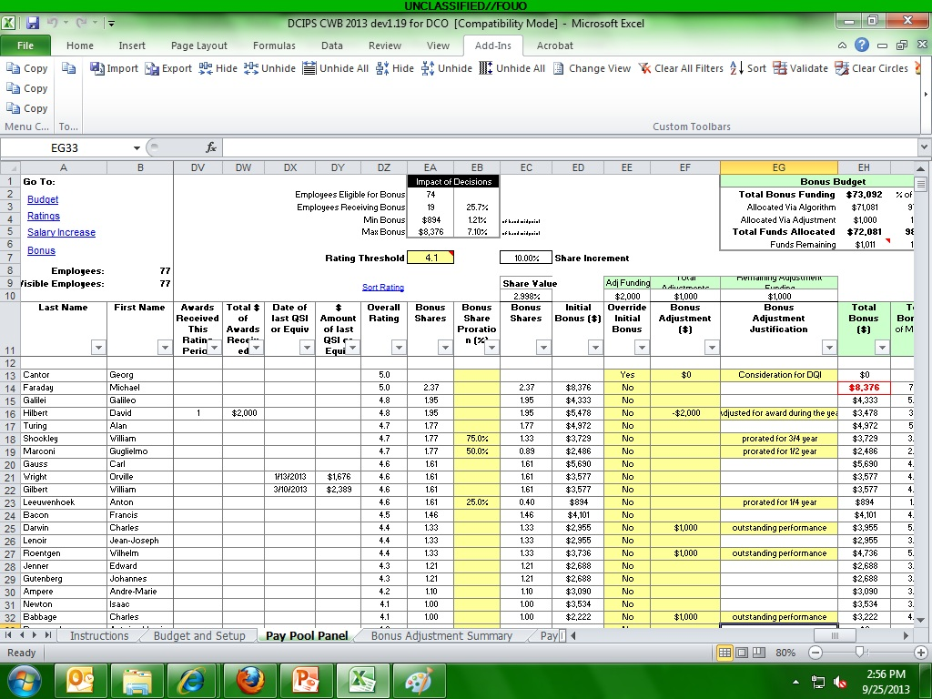
Bonus Adjustment ($)
“Override Initial Bonus” – zeroes out a person’s shared and $ returned to Pool
“Bonus Adjustment Justification” – Proration/Overrides/Adjustments must have a Justification
“Bonus Adjustment ($)” – draws from Adjustment Fund (Budget & Setup worksheet) (+ or -)
Notes:
Overrides zero out a person’s shares and dollars and returns that money to the bonus pool. Adjustments draw from the adjustment fund if you set one up on the Budget & Setup worksheet. Adjustments can be positive or negative. Prorations, overrides, and adjustments must have Justifications.

Slide 4
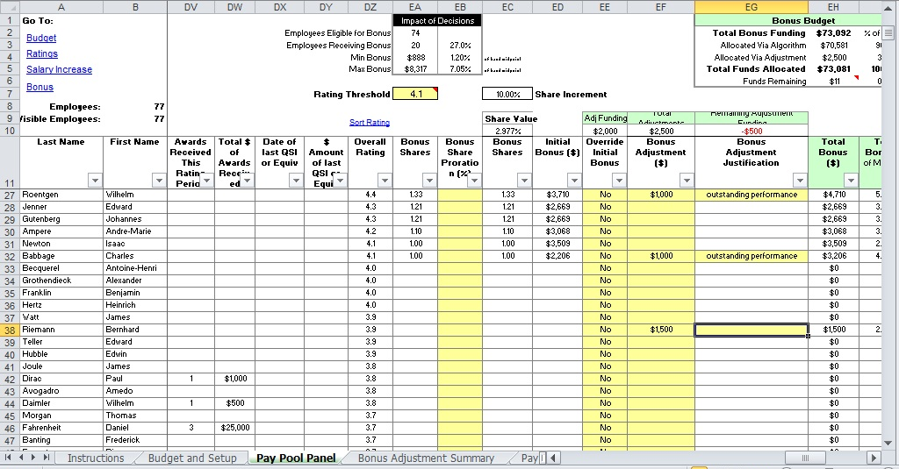
Overspending Adjustments
Notes:
People who don’t get shares (i.e., below the rating threshold) may still receive a bonus as long as their rating is at least Successful. Overspending the adjustment fund takes money from the rest of the bonus pool (i.e., from everyone else’s bonus).

Slide 5
To continue CWB training, view next presentation
“Wildcards”
Notes:
This concludes the eleventh presentation in the 18-part series for CWB training. To continue training, view the next Presentation, entitled Wildcards.

