Slide 1


Bonus Decisions
Notes:
This is the fourteenth presentation in the 18-part series for CWB training. The following slides cover how to interpret bonus decisions and how to enter pay pool panel notes into the CWB tool.

Slide 2
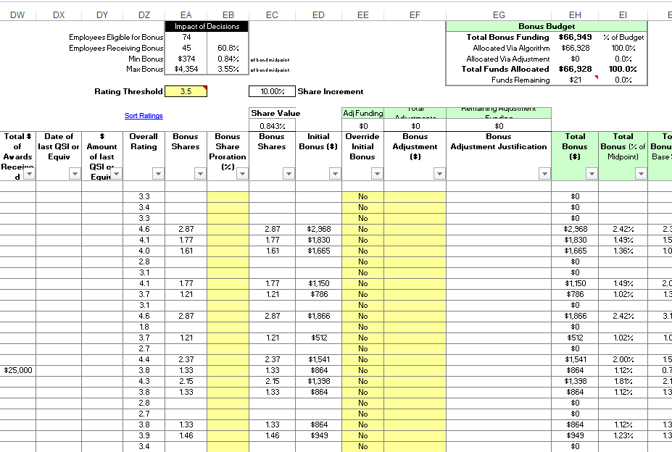
Overview:
Bonus Decisions
Notes:
This slide shows the Bonus Section: (overview), the Rating Threshold, the Bonus Budget, the Overall Ratings, and the Impacts of Decisions.

Slide 3
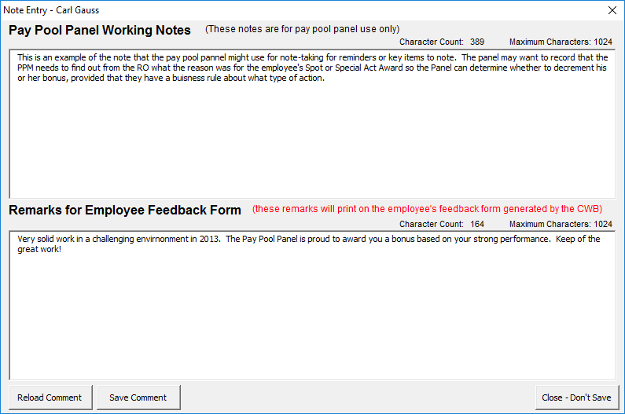
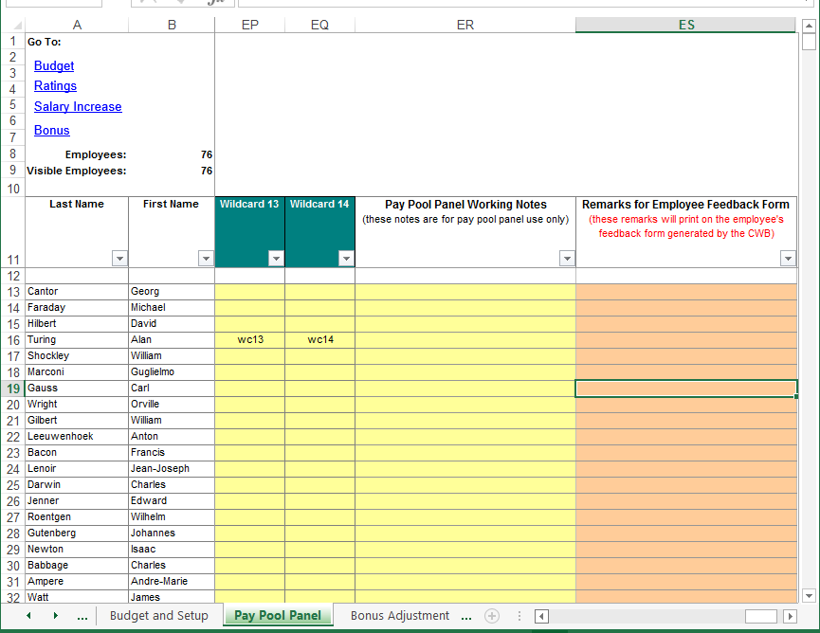
Note Entry
Access the Note Entry interface by double-clicking anywhere in the white cells on a person’s row in the Pay Pool Panel worksheet, or go to the Notes columns (EN and EO)
Notes:
Double click a person’s row to bring up the Note Entry box, which will populate the Notes columns and Employee Feedback form.
You want to input notes to record validation reason for ratings used and historical data and records.
You can use standard template for employee feedback.

Slide 4
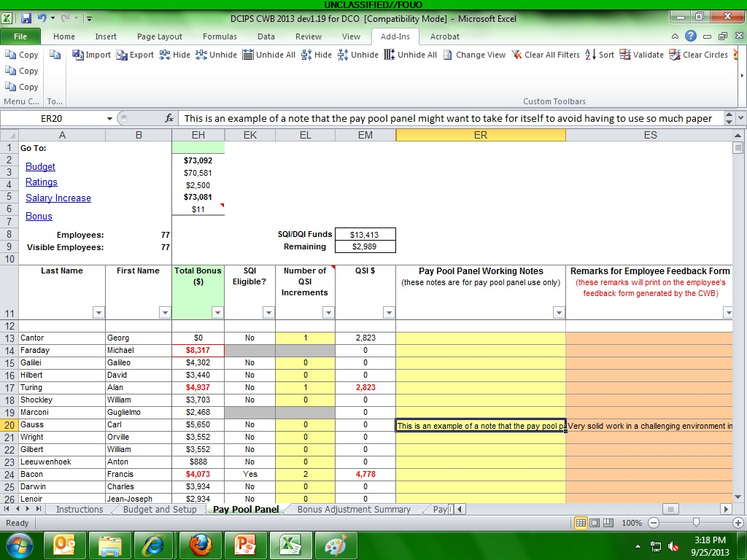

Example of Notes
Notes typed in the pop-up boxes from the Pay Pool Panel worksheet automatically populate the Notes columns and Employee Feedback form
Notes:
This slide shows that notes typed in the pop-up boxes from the Pay Pool Panel worksheet automatically populate the “Pay Pool Panel Working Notes” columns and “Remarks for Employee Feedback Form” columns.
In the 17th presentation entitled, “Generating Feedback Notices” we’ll see how Feedback Forms are generated and where our notes appear on the Feedback Forms.

Slide 5
To continue CWB training, view next presentation
“Certifying the CWB”
Notes:
This concludes the fourteenth presentation in the 18-part series for CWB training. To continue training, view the next Presentation, entitled Certifying the CWB.

