Slide 1


Generating Feedback Notices
Notes:
This is the seventeenth presentation in the 18-part series for CWB training. The following slides cover how to generate feedback notices for employees.

Slide 2
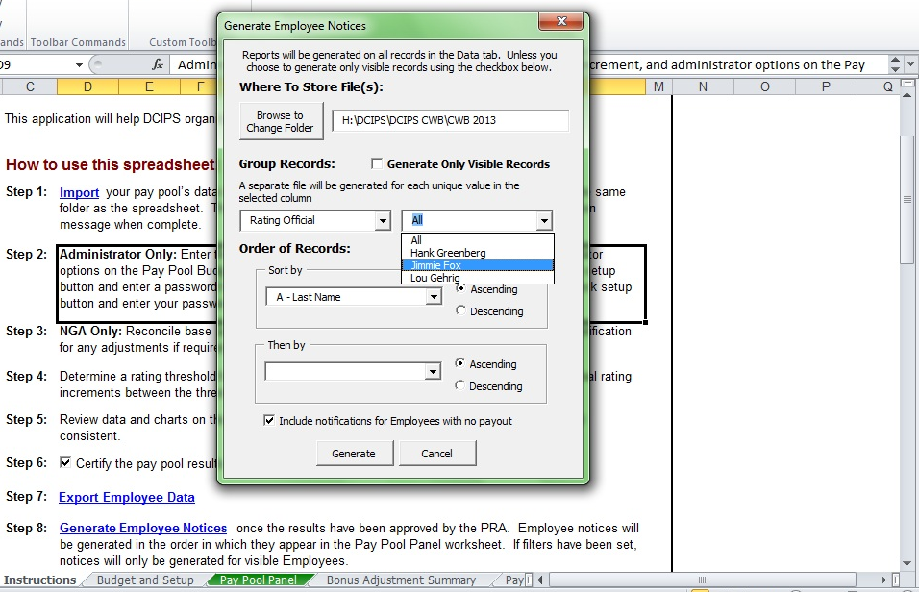
Generate Notices
Generating Employee Notices
Each notice is different Excel worksheet (not workbook)
Can generate by subset (organization, rating official, wildcard, etc.)
Can generate visible records only (from Pay Pool Panel worksheet)
Can set sort order (2 levels)
Can set folder location to store notices
Notes:
Generate Employee Notices – choose whether to print them for all employees or only those who receive a bonus or DQI/SQI. You can generate by what’s visible on the Pay Pool Panel worksheet (using filters on that sheet) or by Rating Official, Reviewing Official, Org ID 1, or Wildcard 1. Here we are generating notices for the employees of one specific Rating Official. We can also sort what order that RO’s employees will be in. We’re also printing a list of all of this RO’s employees so the RO can see no one was left out.
Notices are not mandatory; however, when they are printed out, they are given to the Rating Official ONLY.

Slide 3
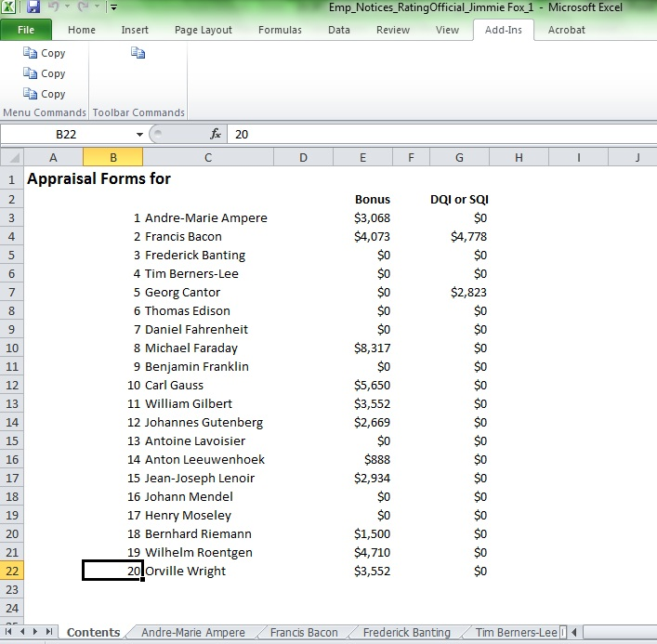
Employees Notices
Notes:
The tool generates a separate Excel file with the notices you choose. Each tab is for a different employee. You could print these out yourself or email this file to the specific RO and have them print out to give to their people.

Slide 4
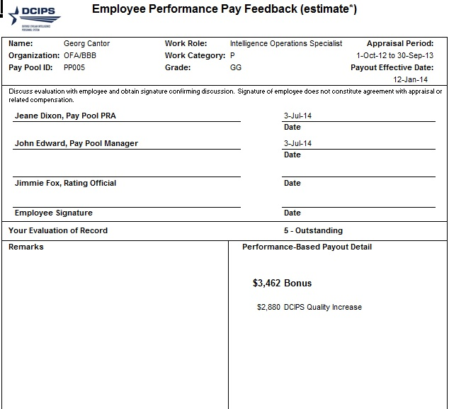
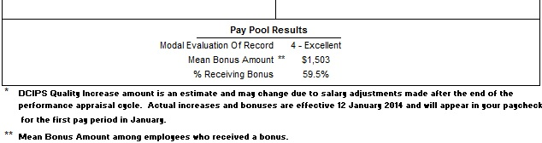
Employee Feedback Forms
Employee feedback forms will ONLY print for employees who get a bonus or QSI by default; user can choose to generate them for everyone (including $0 bonus).
Information on the form includes:
Personnel info
Supervisory chain
Remarks (from Notes page; editable)
Any Bonus or DQI/SQI (projected) from CWB
Pay Pool Statistics:
Mode Evaluation of Record
Mean Bonus Amount
% receiving a Bonus
Notes:
The text at the bottom now reads “Pay Pool Results” instead of “Your Pay Pool Results.”
Information is pre-generated, so there is not need to type any information.

Slide 5
To continue CWB training, view next presentation
“CWB Statistics”
Notes:
This concludes the seventeenth presentation in the 18-part series for CWB training. To continue training, view the next Presentation, entitled CWB Statistics.

