Slide 1


Extracting CWB Data
Notes:
This is the fourth presentation in the 18-part series for CWB training. The following slides cover how CWB data is extracted from DCPDs.

Slide 2
DCPDS CWB Extract
DCPDS
PAA
Step 1
Pay pool data extracted
from DCPDS
Pay pool administrators can download their pay pool data from DCPDS
Each employee in the pay pool must have the correct pay pool identifier
Extract file includes fields such as first and last name, base salary, pay band, organizational information, occupational series, performance ratings…
The Data Extract Creation Tools allows users to build their own extract-like file to import into the CWB, if necessary.
Pay Pool
Extract File
(pipe-delimited text file)
Step 2
Pay pool data imported
into the CWB spreadsheet
CWB
Notes:
This graphic represents the DCPDS CWB Extract process.

Slide 3
Request CWB Extract File
1st - Select CIV Pay Pool Administrator from the Navigator menu
2nd - Select Request CWB Extract File under the CIV Pay Pool Administrator menu
For Command Administrators:
Select the “DCIPS Command Extract Administrator” responsibility;
Navigate to “View/Print Performance Management Reports”
Enter “DCIPS Command CWB Extract” in the Report Name for selection of multiple pay pools by “Agency Group”.
Notes:
This slide shows the steps that Pay Pool Administrators take to request the CWB Extract file.

Slide 4
Enter Pay Pool Information
Process Name: Enter a unique process name of your choice
Mock Pay Pool Data: Select Yes for Mocks, No for real pay pools
Pay Pool Transitioned: Does not apply to DCIPS pay pools
PP Id Segment 1: Enter the pay pool identifier
Pay Pool Cycle Closeout Date: Select 30-Sep-XXXX
Notes:
Pay Pool Administrators enter pay pool information to continue the CWB extract for their Pay Pool, then they click on the “Submit Request” link.

Slide 5
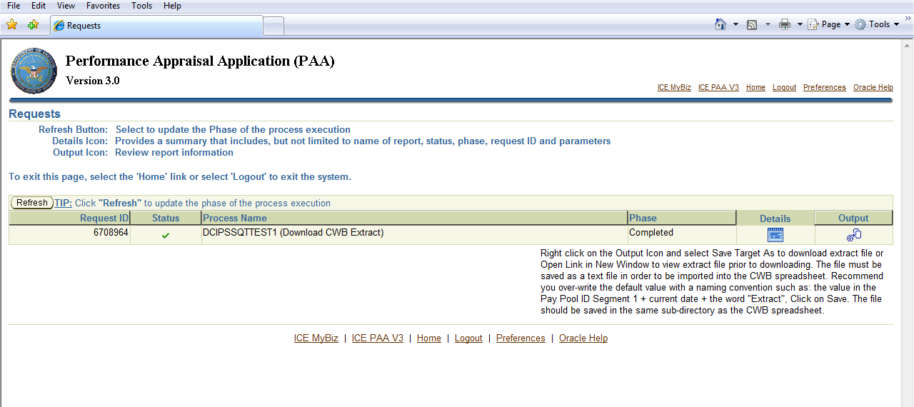
Wait for DCPDS to
Generate the File
Select the “Refresh” button until Phase status changes from “Pending or Running to Completed” an icon appears under Output
Notes:
This slide gives guidance on how the Pay Pool Administrator can access the extract file, once it has been ordered.

Slide 6
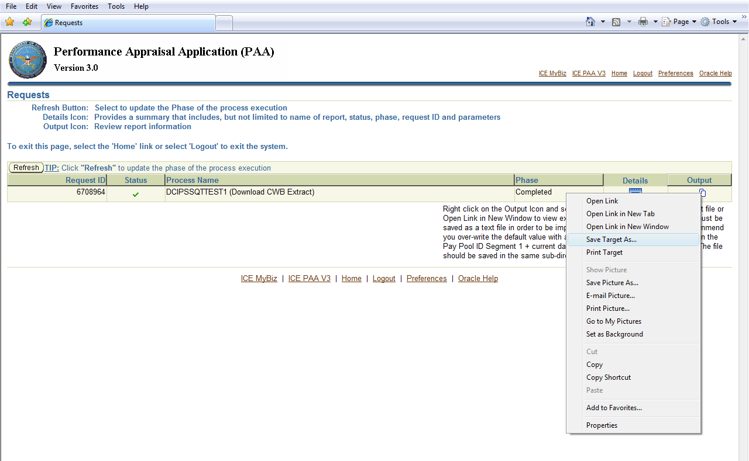
Save the Extract File
Right-click on the output icon and select “Save Target As…”
Save the file on your computer, wherever you keep your CWB
Change the name of the file to something more descriptive.
Notes:
Pay Pool Administrators would continue the CWB extract process by right-clicking on the output icon and selecting “Save Target As…” It is imperative that all extracts are saved in the same file folder that contains the CWB tool. When uploading an extract, the CWB tool will only search within it’s own stored folder.

Slide 7
CWB Extract File and CWB
Save the CWB Extract File and the CWB spreadsheet in the same folder on your computer
Notes:
This slide shows an example of how the CWB extract is saved in the same folder that contains the CWB tool.

Slide 8
To continue CWB training, view next presentation
“Importing CWB Data”
Notes:
This concludes the fourth presentation in the 18-part series for CWB training. To continue training, view the next Presentation, entitled Importing CWB Data.

