Slide 1
Administrator Options
Notes:
This is the seventh presentation in the 18-part series for CWB training. The following slides cover how the administrator can determine which columns will accept or allow additions or edits.

Slide 2
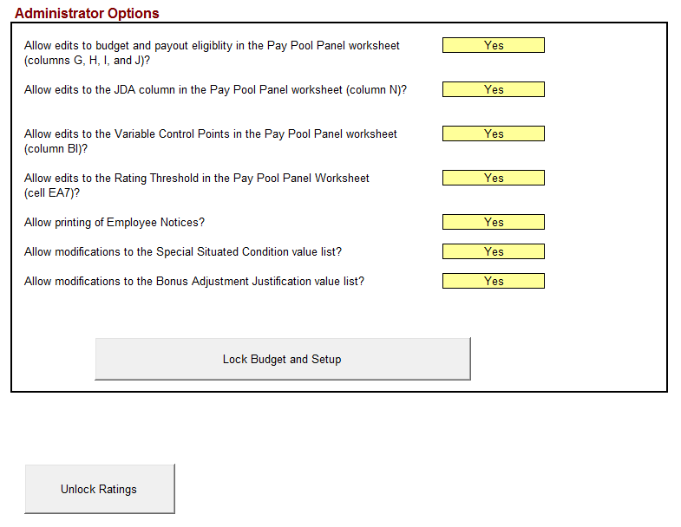
Budget and Setup (cont)
Administrator options set the user’s ability to:
Modify budget entries and payout eligibility parameters
Modify variable control points
Modify the bonus rating threshold
Print employee notices
Options can be locked with password
Notes:
This slide shows the different columns that the Pay Pool Administrator can lock against editing.

Slide 3
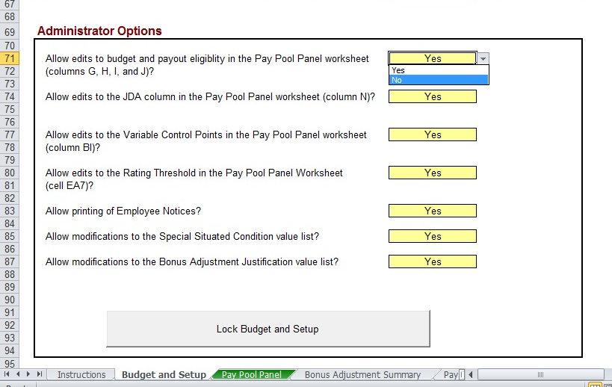
Budget & Setup: Admin Opts
Notes:
This slide shows that the Pay Pool Administrator has chosen to prohibit edits to columns G thru J.

Slide 4
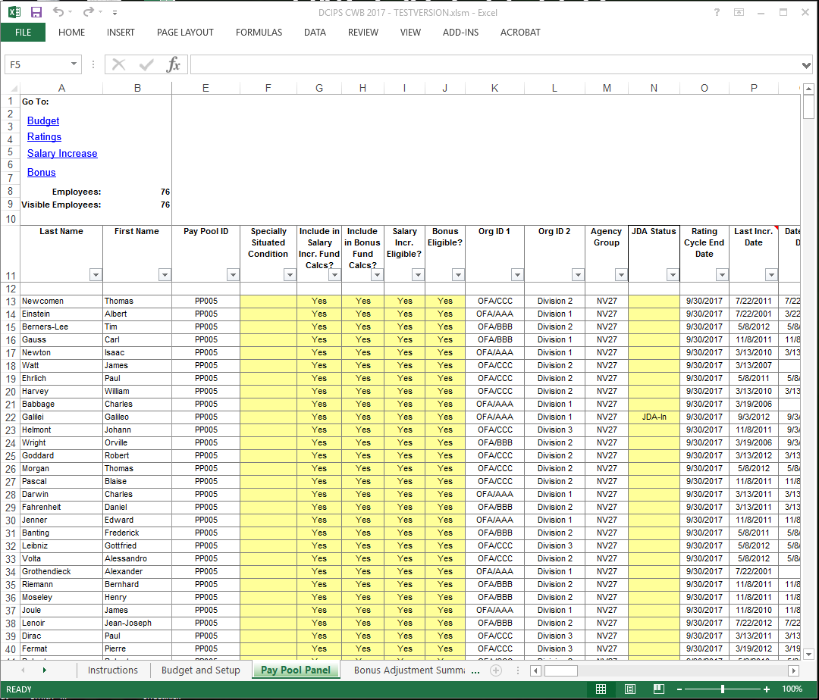
Eligibility Controls Columns G, H, I, and J in Pay Pool Panel Worksheet
Budget Inclusions
Salary Increase & Bonus Eligibility
Notes:
This slide shows Columns G thru J which have been locked against editing by the Pay Pool Administrator.

Slide 5
Unlock/Lock Admin Opts
*Note to remember what password you set if you want to lock
Notes:
If Pay Pool Administrators decide to lock any of the columns, they must assign a password that is longer than three characters. It is imperative that they remember the new password they assigned.

Slide 6
To continue CWB training, view next presentation
“Unlock Ratings”
Notes:
This concludes the seventh presentation in the 18-part series for CWB training. To continue training, view the next Presentation, entitled Unlock Ratings.

