Slide 1
Unlock Ratings
Notes:
This is the eighth presentation in the 18-part series for CWB training. The following slides cover how administrators can unlock rating columns to allow missing performance data to be added.

Slide 2
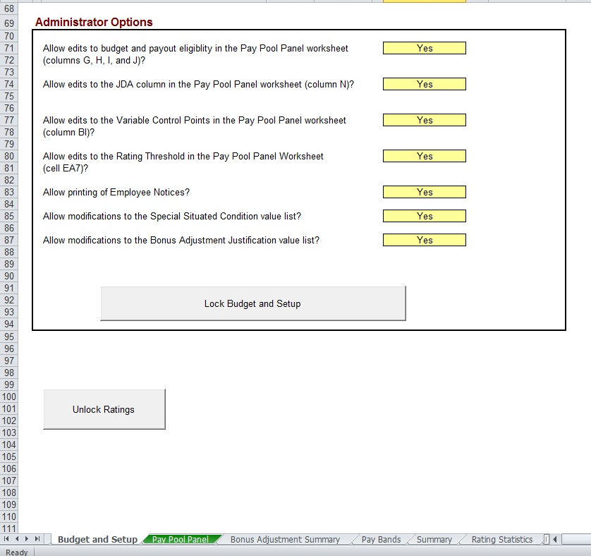
Unlock Ratings
Notes:
This slide shows a larger view of the “Unlock Ratings” button on the Budget and Setup worksheet.

Slide 3
Unlock Ratings
Notes:
This slide shows the password, “unlockratings” that is assigned to all rating columns.

Slide 4
Unlock Ratings (cont)
Unlock ratings
Button to unlock ratings columns is located at bottom of Budget and Setup worksheet
Password is “unlockratings”
Ratings should only be changed due to administrative error or reconsideration
Enter Evaluation of Record first to clear gray formatting
Re-lock the rating columns when finished
Notes:
This slide provides guidance on utilizing the “Unlock Ratings” button.

Slide 5
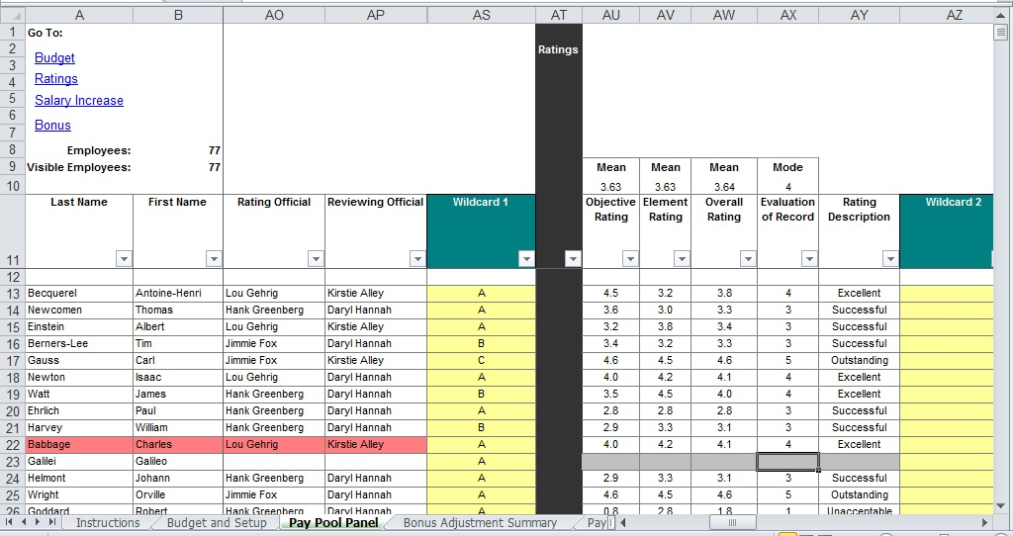
How to Update Missing Data
Notes:
This slide gives guidance on adding performance data that may be missing. You must first click on the unlock ratings button, before you can come to this column and add the missing data.

Slide 6
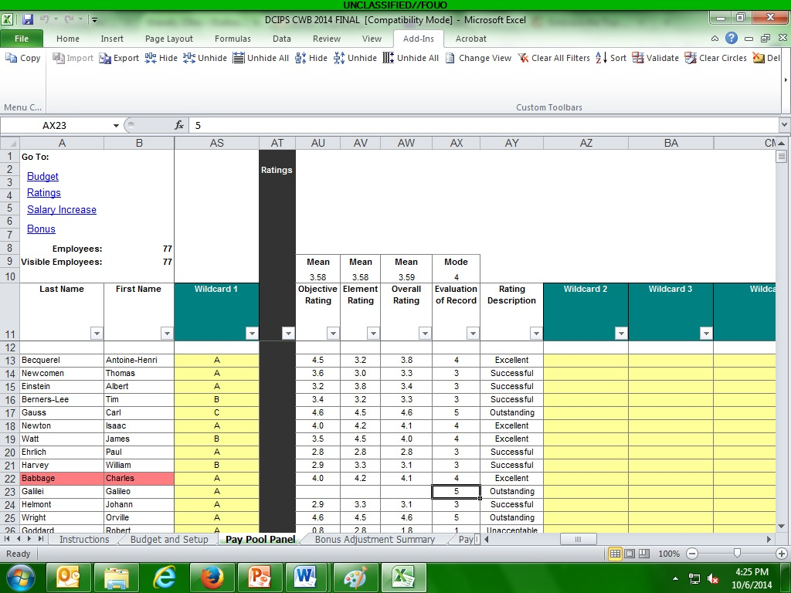
Update Evaluation of Record
Notes:
This slide gives instructions on entering the missing performance data. The Evaluation of Record cell must be populated first, then the other cells will no longer be greyed out.

Slide 7
Update Cont.
Notes:
At this point, you can enter the Objective Rating, Element Rating, and Overall Rating scores.

Slide 8
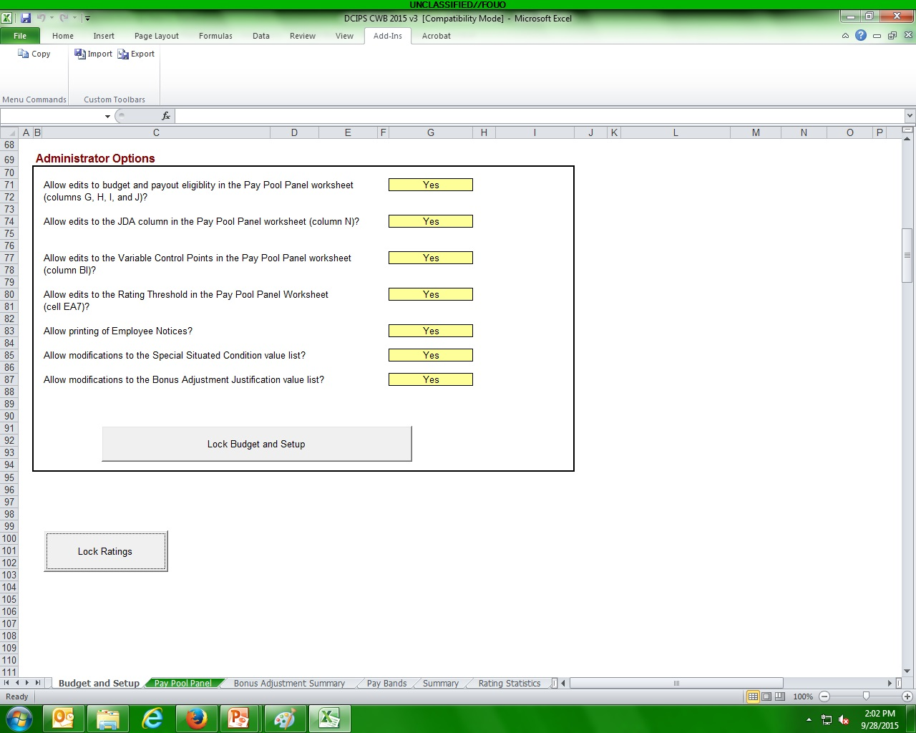
Lock Ratings After Change
Notes:
Go back to the Budget and Setup worksheet and click on the “Lock Ratings” button, to relock columns AU thru AX.

Slide 9
To continue CWB training, view next presentation
“Special Columns”
Notes:
This concludes the eighth presentation in the 18-part series for CWB training. To continue training, view the next Presentation, entitled Special Columns

