Slide 1
DCIPS Payout Analysis Tool (DPAT)
Notes:
Welcome to the DCIPS Payout Analysis Tool (DPAT) Training Presentation.

Slide 2
Using the DPAT
Two types of Imports into the DPAT
Directly from the DCPDS extract
One pay pool – use the same extract file as the CWB uses
Multiple pay pools – use “Command Extract” in DCPDS
Both options have only ratings information, including element and objective ratings
Used for Reviewing Official or PM PRA review
Results of the Pay Pool Panel meeting
Export file from the CWB – same file you upload to DCPDS
Directly from the CWB – automatically generates an export file
Used for PP PRA review
CANNOT import from one DPAT to another
Notes:
There are two types of imports into the DPAT. The first import available is the same extract file used to upload into the CWB. Since this file is created before CWB bonus deliberations, it will only contain data on element and objective ratings. The second import available is the export file from the CWB, after bonus deliberations. The second option is the same file that you uploaded back into DCPDS to pay bonuses. These imports will assist with Pay Pool Performance Review Authority reviews. Please note that you cannot upload from one DPAT tool to another DPAT tool.

Slide 3
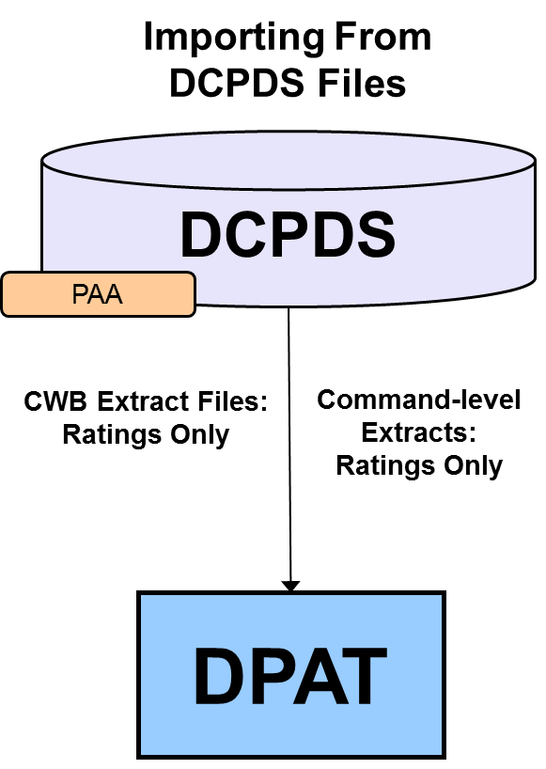
Importing into the DPAT
Importing From CWB Files
CWB
Spreadsheet
(pay pool 1)
CWB Export Files: Ratings and Payouts
CWB
Spreadsheet
(pay pool 2)
DPAT
CWB
Spreadsheet
(pay pool 3)
Notes:
This graphic represents the two different ways you can import files into the DPAT.

Slide 4
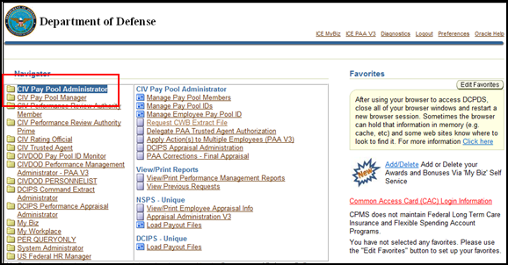
Request Extract for Multiple Pay Pools
Select DCIPS Command Extract Administrator from the Navigator menu
Select View/Print Performance Management Reports under the View/Print Reports menu
Enter “DCIPS Command CWB Extract” in Report Name on the next page to select multiple pay pools by “Agency Group”
Notes:
This slide shows the steps the Pay Pool Administrators take to request the Command-level extract files from DCPDS. This option is used when extracting data for multiple pay pools, when there is one Pay Pool Administrator within an Agency Group. For instance, this could be used by a Pay Pool Administrator to pull an extract for all pay pools within Space Command.

Slide 5
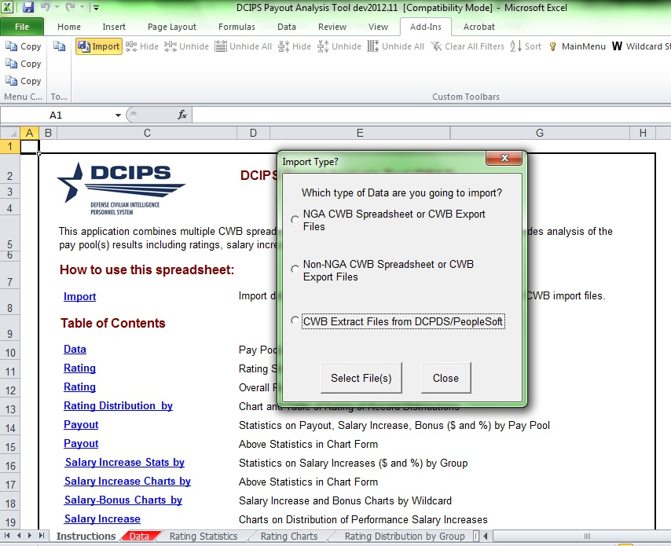
Using the DPAT
TIP: Return to the Instructions Worksheet at any time by clicking the Main Menu button on the Custom Toolbar.
Choose the second (first non-NGA) option to import from CWB file(s) with ratings and bonus results
Choose the third option to import DCPDS extract files with ratings info only
Notes:
Select import type:
From CWB: AFTER Pay Pool Panel Meeting
From DCPDS: BEFORE Pay Pool Panel Meeting

Slide 6
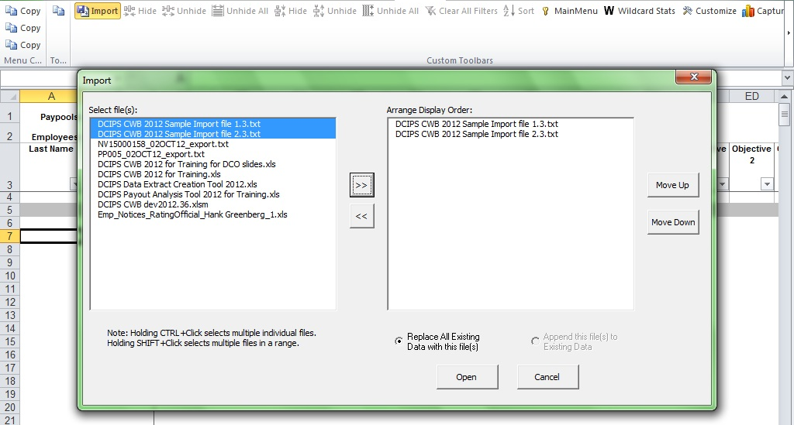
DPAT – Import Files
Notes:
Choose which files to import and click the arrow in the middle of the box. Move the order of the pay pool files up or down – this will affect how they display on charts.

Slide 7
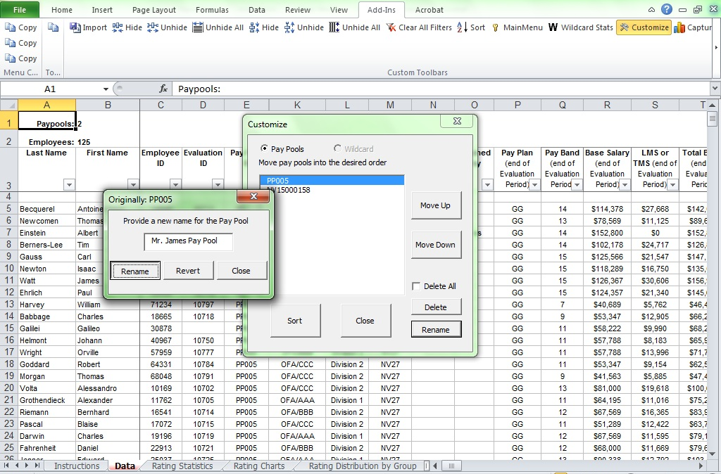
Customize Name
Notes:
The Customize button lets you give each pay pool an “Alias” that will display on charts and statistics, as well as reorder the pay pools and even delete pay pool data out of the DPAT.

Slide 8
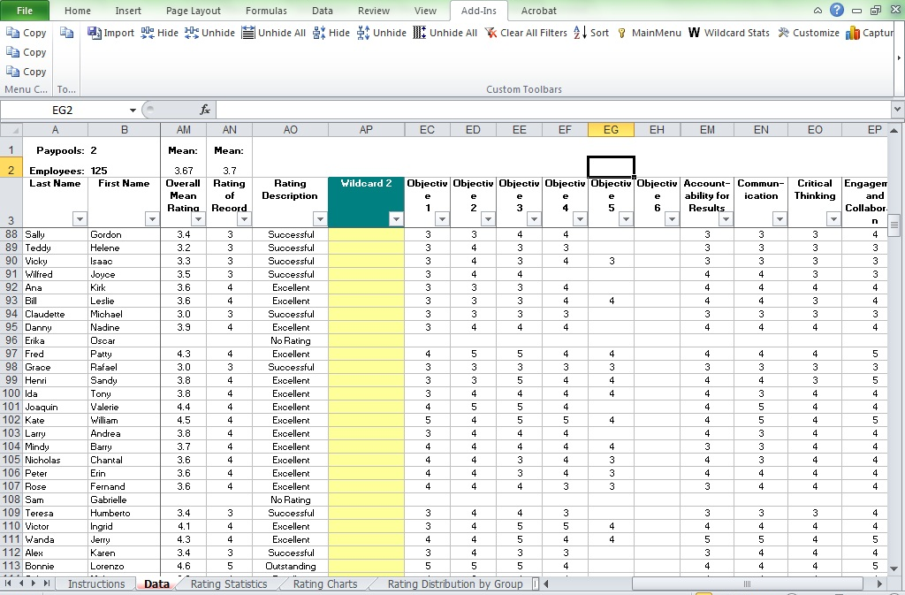
View Objective/Element Ratings
DCPDS extract files contain element and objective ratings that can be viewed in spreadsheet format in the DPAT
Only the rating stats and charts pages will be visible when importing directly from DCPDS
Notes:
The Performance Management Performance Review Authority or the Reviewing Official might want to view Element and Objective ratings in spreadsheet format. If so, import the extract file from DCPDS directly into the DPAT. Do not go through the CWB for this – element and objective data are lost in that process!

Slide 9
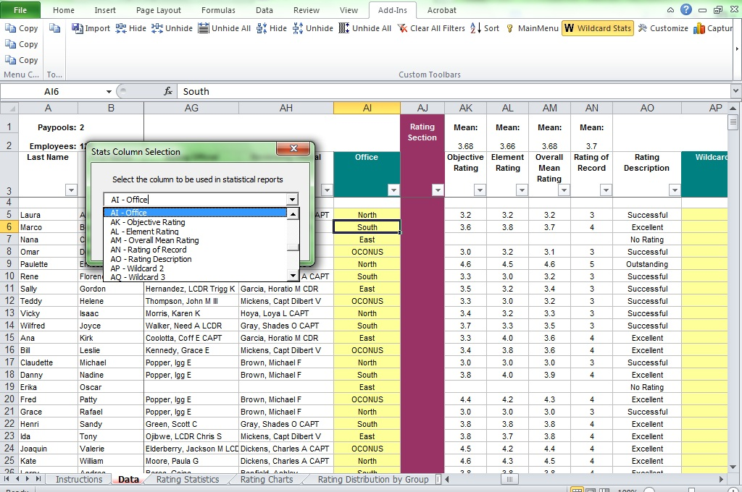
Wildcard Stats
Notes:
Wildcard stats button works the same as it does in CWB. Wildcard values entered into CWB files are imported into the DPAT but header names are not. Bottom of the Instructions page in DPAT shows which wildcard was most recently analyzed.

Slide 10
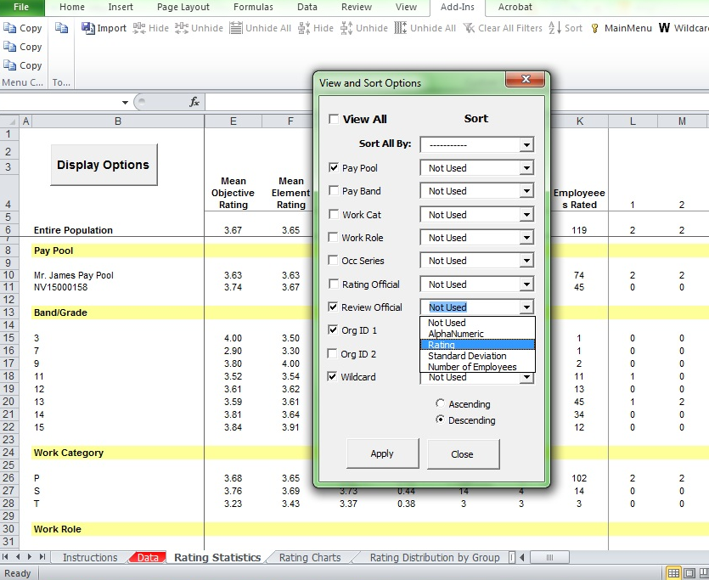
Display: View & Sort Option
Notes:
Salary Statistics and Bonus Statistics worksheets have numerous breakdowns of payouts, like the Rating Statistics sheet. The other Stats sheets include the Display Options button, which allows you to display some or all of the breakdowns to make it easier to digest, like on the Ratings Statistics worksheet.

Slide 11
Rating Distribution by Group
“Office” is located in Wildcard 1 in this example. Using the Wildcard Stats button generates stats and charts by the wildcard of your choice for all relevant worksheets.
The Capture Charts button works the same as in the CWB.
Notes:
The top chart on the Ratings Distribution by Group worksheet shows rating distributions by pay pool. The bottom chart analyzes a wildcard column.

Slide 12
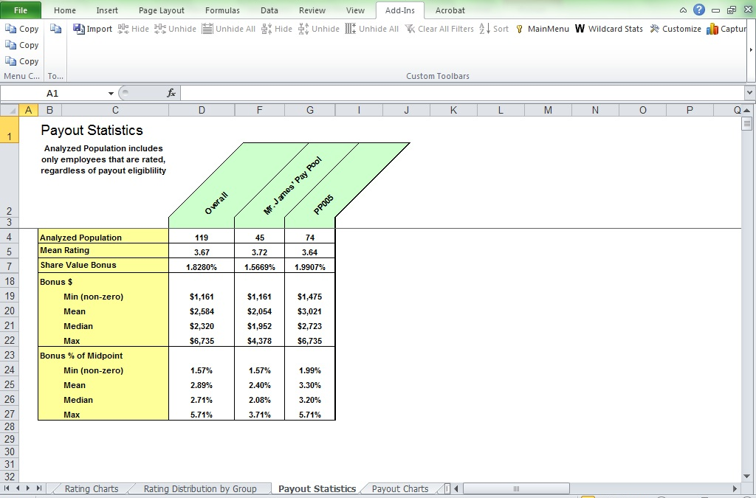
Payout Statistics
The Payout Statistics worksheet shows $ and % salary increase and bonus payouts by pay pool.
This allows the user to quickly generate summary payout statistics.
Clicking “non-NGA” in the import hides all salary increase information, which is not pertinent to your pay pools.
Notes:
The Payout Statistics worksheet shows dollar and percentage salary increase and bonus payouts by pay pool. This allows the user to quickly generate summary payout statistics. Clicking “non-NGA” in the import hides all salary increase information, which is not pertinent to your pay pools.

Slide 13
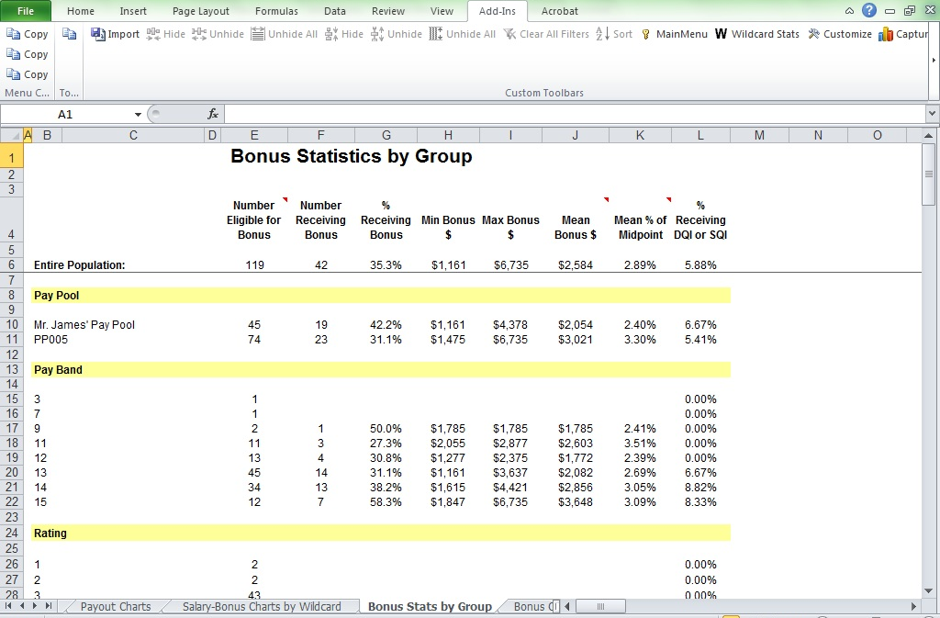
Bonus Stats by Group
Bonus Statistics by Group worksheet shows $ and % bonus payouts, and % receiving a bonus, by pay pool, wildcard, and other categories.
Notes:
Bonus Statistics by Group worksheet shows dollars and percentage bonus payouts, and percentage receiving a bonus, by pay pool, wildcard, and other categories.

Slide 14
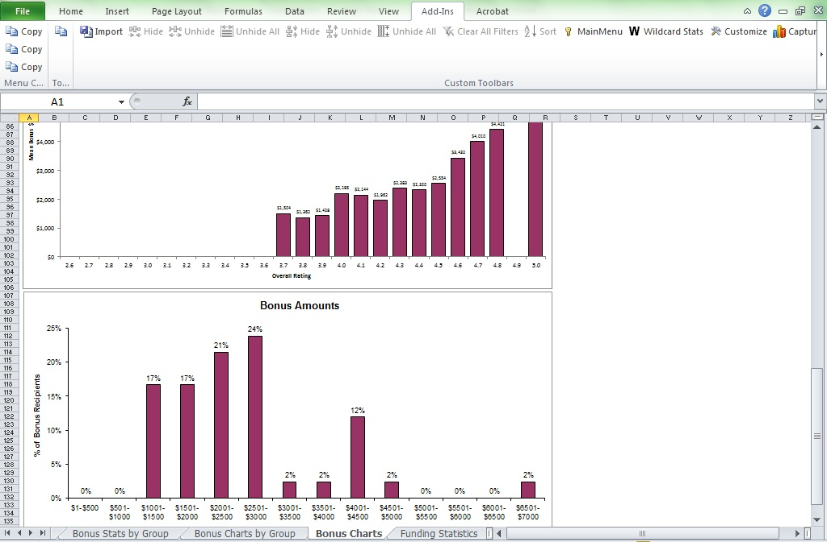
Bonus Charts
Bonus Charts by Group show the “pictures” to go with the “numbers” on the Bonus Stats by Group worksheet.
Bonus Charts displays histograms and scatter plots of bonus payouts across pay pools, including the new Bonus $ distribution chart.
Notes:
The Bonus Charts worksheet includes the charts that are in the CWB. Capture Chart Images works the same as it does in the CWB. Scatter plots and the histogram at the bottom of the page show the relationship between ratings and bonus levels.

Slide 15
References
Get the User Guides for CWB, DPAT, and Extract Creation Tool from your component DCIPS POC.
DCIPS CWB Extract & Upload-Payout Processes User Guide covers common error messages and what to do about them.
Your component, command, and pay pool should have their own guidance documents and business rules. Please read them!!
Notes:
Get the User Guides for CWB, DPAT, and Extract Creation Tool from your component DCIPS POC. DCIPS CWB Extract & Upload-Payout Processes User Guide covers common error messages and what to do about them. Your component, command, and pay pool should have their own guidance documents and business rules. Please read them!!

Slide 16
Point of Contact
Remember to read the following guides and practice using the CWB Tool with the DCIPS CWB test data:
DCIPS CWB Extract & Upload-Payout Processes User Guide
DCIPS CWB User Guide
DCIPS DPAT User Guide
Contact Information:
Phone number: 703-692-3706
Email: Olufemi.o.adebiyi.ctr@mail.mil
Notes:
This concludes the training presentation.
Remember to read the DCIPS CWB Extract & Upload-Payout Processes User Guide, DCIPS CWB User Guide, and DCIPS DPAT User Guide. Utilize the CWB tool with the CWB test data to practice using the CWB tool to make bonus decisions. For any questions, contact Femi at the email or phone number listed here.

