Slide 1
Lesson 5: Employment and Placement
Duration: 3 hours
DCIPS Employment and Placement
Slide 5- 1

Slide 2
Lesson 5 Topics
Lesson 5 Topics
Topic 1 – DCIPS and the Excepted Service Under Title 10
Topic 2 – Qualification Standards
Topic 3 – DCIPS Appointing Authority and Hiring Flexibilities
Topic 4 – Component-Specific Internal Placement Flexibilities
Topic 5 – Competitive/Non-Competitive Actions
Topic 6 – DCIPS Trial Periods
Topic 7 – Joint Duty Assignments
Topic 8 – Quality in Employment and
Placement Outcomes
DCIPS Employment and Placement
Slide 6- 2

Slide 3
DCIPS and the Excepted Service Under Title 10
DCIPS and the Excepted Service Under Title 10
What does being in the excepted service under Title 10 mean?
What does Title 5 competitive service refer to?
Does Title 5 also have excepted service positions?
How does DCIPS protect employees’ fundamental rights?
What should Defense Intelligence Components consider when staffing positions?
What flexibilities are there for DCIPS areas of consideration and open periods?
Does DCIPS require that a certain area of consideration be used when filling positions?
DCIPS Employment and Placement
Slide 5- 3

Slide 4
Moving to DCIPS and the Excepted Service
Moving to DCIPS and the Excepted Service
All new DCIPS employees are required to complete a two-year DCIPS trial period
DCIPS trial periods are two years of continuous service
Completion of a probationary or trial period under another personnel management system (e.g., Title 5 competitive service) does not waive the DCIPS two-year trial period
Vacancy announcements for Defense Intelligence positions must clearly note that positions are in the excepted service and covered by DCIPS
Applicants must sign a statement acknowledging the conditions of employment or assignment that are unique to Defense Intelligence positions
DCIPS Employment and Placement
Slide 5- 4

Slide 5
Veterans’ Preference
Complete the worksheet on page 5-13 in the Participant Guide
Refer to Veterans’ Preference in the What You Should Know box on pages 5-10_5-12 of the Participant Guide to help you with this exercise.
You will have 5 minutes to complete the worksheet.
DCIPS Employment and Placement
Slide 5- 5

Slide 6
Passovers
Passovers
Passovers of 30% or more compensably disabled veterans are expected to be exceptions and are especially rare
DCIPS Employment and Placement
Slide 5- 6

Slide 7
Qualification Standards
Qualification Standards
General qualification profiles include descriptions of the competencies, knowledge, skills, abilities, education, training, and the type and quality of experience required for successful job performance in the DCIPS Occupational Structure
DCIPS Employment and Placement
Slide 5- 7

Slide 8
Qualification Standards Table
Qualification Standards Table
DCIPS Work Category | Work Level | Pay Band | Minimum Qualifying Grade Using General Schedule (GS) Grade-Based Standards
Technician/ Administrative Support | 1 | 1 | GG-01
Technician/Administrative Support | 2 | 2 | GG-07
Technician/ Administrative Support | 3 | 3 | GG-11
Professional | 1 | 2 | GG-07
Professional | 2 | 3 | GG-11
Professional | 3 | 4 | GG-13
Professional | 4 | 5 | GG-15
Supervision/Management | 2 | 3 | GG-11
Supervision/Management | 3 | 4 | GG-13
Supervision/Management | 4 | 5 | GG-15
DCIPS Employment and Placement
Slide 5- 8

Slide 9
Appointing Authority
Appointing Authority & Hiring Flexibilities
10 U.S.C. 1601 is the appointing authority for all Defense Intelligence positions
Appointments may be:
Permanent
Indefinite
Temporary
Term
Merit system principles must be upheld at all times
DCIPS Employment and Placement
Slide 5- 9

Slide 10
Hiring Flexibilities Scenario
Hiring Flexibilities Scenario
Elizabeth, a member of the Defense Intelligence Agency and a reservist, has been called to active duty for a period of 18 months. Marvin, her supervisor, doesn’t have anyone who can be detailed to support this position. He is considering how to get the work done while Elizabeth is gone and thinks the best course of action is to fill the position for the period of Elizabeth’s absence.
DCIPS Employment and Placement
Slide 5- 10

Slide 11
Internal Placement Flexibilities
Internal Placement Flexibilities
DCIPS provides the flexibility to quickly assign the
right people where they are needed
DCIPS Employment and Placement
Slide 5- 11

Slide 12
Key Terms
Can You Define These Key Terms?
Promotion
Reassignment
Reduction in Band or Grade
DCIPS Employment and Placement
Slide 5- 12

Slide 13
Exceptions to Competition
Exceptions to Competition
Lateral Transfers
Reassignments
Details
Developmental Programs
Realignment
Accretion of Duties
DCIPS Employment and Placement
Slide 5- 13

Slide 14
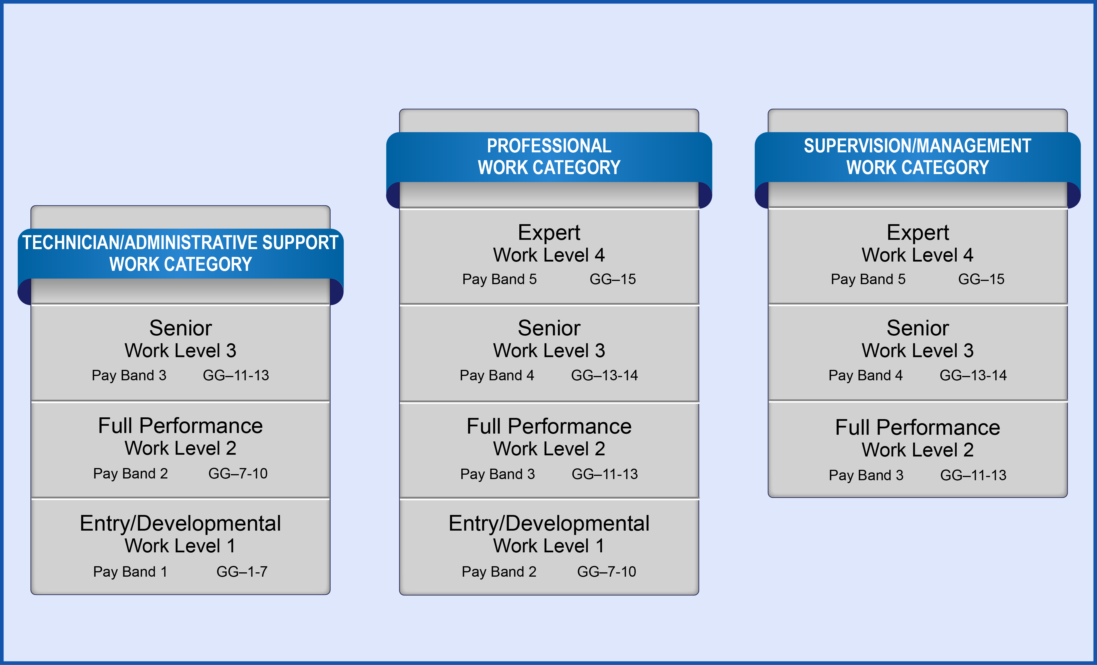
DCIPS Occupational Structure
DCIPS Occupational Structure
DCIPS Employment and Placement
Slide 5- 14

Slide 15
DCIPS Competitive Actions Game
DCIPS Competitive Actions Game
Instructions: Create 5 questions about competitive actions to ask the other team. At least two questions should be scenario-based and focus on:
The type of action required
Whether the action requires competition
Reason for your answer
DCIPS Employment and Placement
Slide 5- 15

Slide 16
Trial Periods
Trial Periods
All new Defense Intelligence employees will serve a two-year trial period
Once an employee has completed a DCIPS trial period, he/she will not need to complete another one
A Defense Intelligence employee who moves to another Defense Intelligence position or Component before completing the trial period does not have to start over, but will complete the trial period in the new position or Component
DCIPS Employment and Placement
Slide 5- 16

Slide 17
Joint Duty Assignments
Joint Duty Assignments
The JDA Program is a leadership development program whose purpose is to build a cadre of intelligence professionals with experience in more than one IC element.
DCIPS Employment and Placement
Slide 5- 18

Slide 18
JDA Scenario
JDA Scenario
Management has been trying for some time to fill a procurement analyst position. The position is in the Professional Work Category at the Full Performance Work Level, GG-13 and requires some unique skills. The position has been advertised at least four times; generally, it does not get any qualified applicants.
One of the problems with the position is that it is located in an isolated area. When management has tried to hire for these types of positions in the past, they have had a great deal of difficulty and some positions have remained unfilled for months, although other organizations within the IC have employees with the necessary skill sets.
DCIPS Employment and Placement
Slide 5- 19

Slide 19
JDA Credit Criteria
JDA Credit Criteria
Full-Time Employees
Part-Time Employees
Deployment to a Combat Zone
Multiple Assignments
DCIPS Employment and Placement
Slide 5- 20

Slide 20
Employment and Placement Metrics
Employment and Placement Metrics
Time-to-Fill
Vacancy Rate
Transparency
Collaboration
Quality
DCIPS Employment and Placement
Slide 5- 21

Slide 21
Lesson 5 Review
Lesson 5 Review
Topic 1 – DCIPS and the Excepted Service Under Title 10
Topic 2 – Qualification Standards
Topic 3 – DCIPS Appointing Authority and Hiring Flexibilities
Topic 4 – Component-Specific Internal Placement Flexibilities
Topic 5 – Competitive/Non-Competitive Actions
Topic 6 – DCIPS Trial Periods
Topic 7 – Joint Duty Assignments
Topic 8 – Quality in Employment and
Placement Outcomes
Slide 5- 22
DCIPS Employment and Placement
Slide 3- 2

